Slide 1
Neural LMs and Recurrent Neural Nets
W266: Natural Language Processing

Slide 2
Agenda
Learning Optimizations
Negative Sampling
Hierarchical Softmax
Processing Sequences
Window Models
Recurrent Neural Network (RNN)
Backpropagation
Long Short-Term Memory (LSTM)

Slide 3
Reminders
Assignment 2: October 7
Text processing
Sentiment Treebank and Naive Bayes
Neural Bag-of-Words
Project Proposal: October 14
200-300 words
At least four references
Details in Guidelines

Slide 4
Before we start: Optimizations
A language model is a classifier: P(next word | previous words).
This presents a challenge to the classifier models we’ve built so far...

Slide 5
Optimizations
Distributed Representations of Words and Phrases and their Compositionality Mikolov et al. (2013)
Negative Sampling
Hierarchical Softmax

Slide 6
Recall: Final Affine Layer
h_{final} W_{out} + b_{out}
z
P(classes | input)
h_{final}
softmax(z)
Xentropy_loss(.)
How many “classes” do we have when our task is language modeling?
What is the dimension of z?
How do you calculate a single element of z?
Do you need to compute all z for softmax?

Slide 7
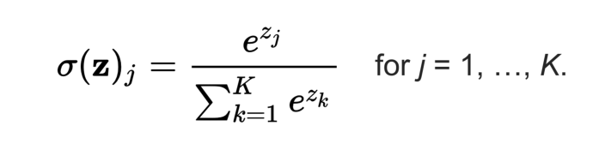
Why is softmax slow?
We learned in A1’s Information Theory that there is a trick to computing xentropy if one of the distribution is one-hot. What was it?
Why doesn’t it help much here?

Slide 8
Why is softmax slow?
We learned in A1’s Information Theory that there is a trick to computing xentropy if one of the distribution is one-hot. What was it?
-lg(P(correct class | input)), don’t need any other probabilities
Why doesn’t it help much here?
Still need all the logits to compute the P(correct class | input)!

Slide 9
Entropy calculation
Assume the correct class is “j”:

Slide 10
Negative Sampling: Lazy softmax
Regular:
Negative Sample:
Only compute a few z_{i}.
Approximate the error function
Sample a subset of incorrect responses
Use a modified unigram distribution
Notes:
Empirically found unigram ^ ¾ to be a good distribution to use; power < 1 gives a bit less weight to really common words that are less useful as contrast.

Slide 11
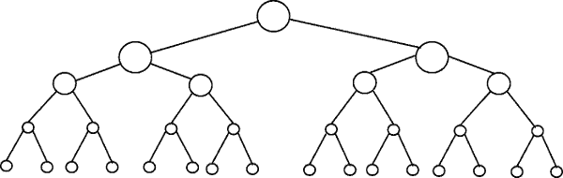
Hierarchical Softmax
the
and
for
of
cat
dog
...

Slide 12
Hierarchical Softmax
the
and
for
of
cat
dog
...
Build a tree!
Huffman Tree
WordNet
Word Clustering

Slide 13
Hierarchical Softmax
n₁
n₂
n₃
n₄
the
and
for
of
cat
dog
...

Slide 14

Hierarchical Softmax
n₁
n₂
n₃
n₄
the
and
for
of
cat
dog
...
Create a vector v for each internal node

Slide 15
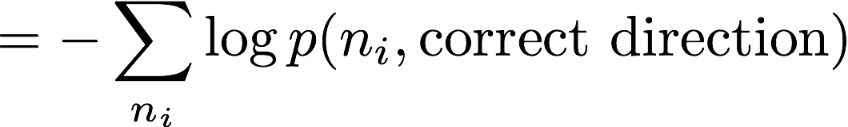
Hierarchical Softmax Error
Error only depends on path to correct word
log |V| terms instead of |V|

Slide 16
Neural Language Models

Slide 17
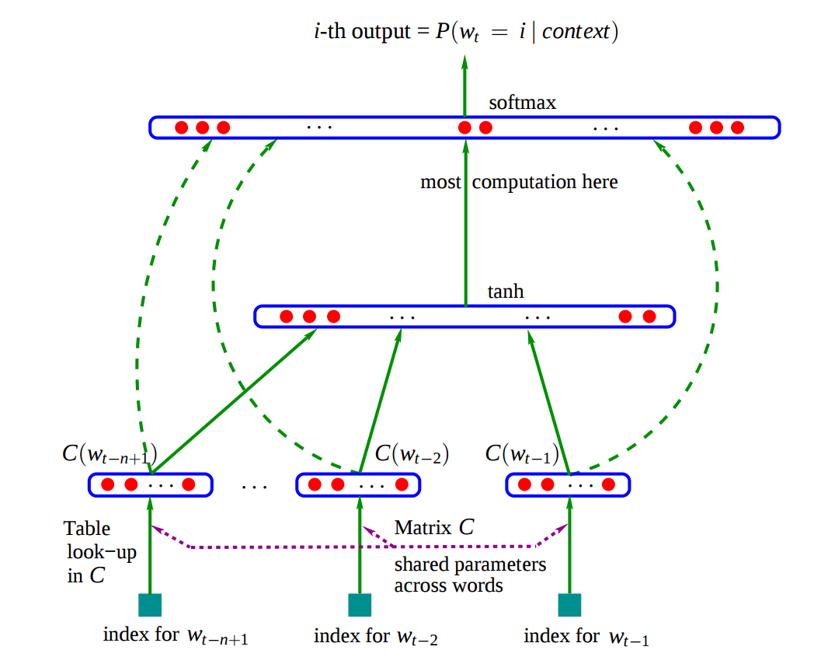
Feed Forward Neural Language Model
Neural Probabilistic Language Model (NPLM) (Bengio et al. 2003)
Softmax Output
Concatenated Embeddings
E
E
E
Context Word i-3
Context Word i-2
Context Word i-1

Slide 18
Window Models
Generic architecture
Useful for language modeling, tagging and entity recognition
What are the advantages of neural window models?
No issues with sparsity anymore
Can generalize between two tokens that are nearly the same
Softmax Output
Concatenated Embeddings
E
E
E
Context Word i-3
Context Word i-2
Context Word i-1

Slide 19
Window Models
Generic architecture
Useful for language modeling, tagging and entity recognition
What are the limitations of Window Models?
Blind to Input Text Outside of Window Text outside of the fixed window is ignored when making predictions. Ignores Surrounding Predictions Predictions for the prior and next sequence predictions don't inform current position.*
No Modeling of Whole Sequence Level Information Makes no attempt to integrate information across a sequence an use if for making predictions. Why still use them? Fast to train and use.
Softmax Output
Concatenated Embeddings
E
E
E
Context Word i-3
Context Word i-2
Context Word i-1
* "Window models" that used predictions from prior positions can be characterized as an RNN.

Slide 20
Aside: Useful in other tasks
Generic architecture
Useful for language modeling, tagging and entity recognition
Softmax Output
Concatenated Embeddings
E
E
E
Context Word (L)
Center Word
Context Word (R)

Slide 21
NPLM: Jupyter notebook
https://github.com/datasci-w266/2018-fall-main/blob/master/materials/nplm/nplm.ipynb

Slide 22
Modeling Sequences: RNNs
(Can we do better?)

Slide 23
Processing Sequences
Y₀ Y₁ Y₂ Y₃ Y₄ Y_{5 ...} Y_{n}
Output
How should we handle sequence data?
Time
X₀ X₁ X₂ X₃ X₄ X_{5 ...} X_{n}
Input
Part of Speech Tagging Input: Alice solved the problem. Output: Alice/NNP solved/VBD the/DT problem/NN ./.
Input: The horse ran past the barn fell. Output: The/DT horse/NN ran/VBD past/JJ the/DT barn/NN fell/VBD ./.
Input: The baseline is the cosine of binary sentence vectors with each dimension representing whether an individual word appears in a sentence. Output: The/DT baseline/NN is/VBZ the/DT cosine/NN of/IN binary/JJ sentence/NN vectors/NNS with/IN each/DT dimension/NN representing/VBG whether/IN an/DT individual/JJ word/NN appears/VBZ in/IN a/DT sentence/NN ./.

Slide 24
Processing Sequences
Y₀ Y₁ Y₂ Y₃ Y₄ Y_{5 ...} Y_{n}
Output
How should we handle sequence data?
Problem (1) Basic neural networks assume fixed dimensional inputs and outputs.
Time
X₀ X₁ X₂ X₃ X₄ X_{5 ...} X_{n}
Input
Part of Speech Tagging Input: Alice solved the problem. Output: Alice/NNP solved/VBD the/DT problem/NN ./.
Input: The horse ran past the barn fell. Output: The/DT horse/NN ran/VBD past/JJ the/DT barn/NN fell/VBD ./.
Input: The baseline is the cosine of binary sentence vectors with each dimension representing whether an individual word appears in a sentence. Output: The/DT baseline/NN is/VBZ the/DT cosine/NN of/IN binary/JJ sentence/NN vectors/NNS with/IN each/DT dimension/NN representing/VBG whether/IN an/DT individual/JJ word/NN appears/VBZ in/IN a/DT sentence/NN ./.

Slide 25
Processing Sequences
Y₀ Y₁ Y₂ Y₃ Y₄ Y_{5 ...} Y_{n}
Output
How should we handle sequence data?
Problem (1) Basic neural networks assume fixed dimensional inputs and outputs.
Solution Construct a network along the sequence
Time
X₀ X₁ X₂ X₃ X₄ X_{5 ...} X_{n}
Input
Part of Speech Tagging Input: Alice solved the problem. Output: Alice/NNP solved/VBD the/DT problem/NN ./.
Input: The horse ran past the barn fell. Output: The/DT horse/NN ran/VBD past/JJ the/DT barn/NN fell/VBD ./.
Input: The baseline is the cosine of binary sentence vectors with each dimension representing whether an individual word appears in a sentence. Output: The/DT baseline/NN is/VBZ the/DT cosine/NN of/IN binary/JJ sentence/NN vectors/NNS with/IN each/DT dimension/NN representing/VBG whether/IN an/DT individual/JJ word/NN appears/VBZ in/IN a/DT sentence/NN ./.

Slide 26
Processing Sequences
Y₀ Y₁ Y₂ Y₃ Y₄ Y_{5 ...} Y_{n}
Output
How should we handle sequence data?
Problem (1) Basic neural networks assume fixed dimensional inputs and outputs.
Solution Construct a network along the sequence
Problem (2) Sentences vary in length, weights for longer sequence positions would rarely be trained.
Time
X₀ X₁ X₂ X₃ X₄ X_{5 ...} X_{n}
Input
Part of Speech Tagging Input: Alice solved the problem. Output: Alice/NNP solved/VBD the/DT problem/NN ./.
Input: The horse ran past the barn fell. Output: The/DT horse/NN ran/VBD past/JJ the/DT barn/NN fell/VBD ./.
Input: The baseline is the cosine of binary sentence vectors with each dimension representing whether an individual word appears in a sentence. Output: The/DT baseline/NN is/VBZ the/DT cosine/NN of/IN binary/JJ sentence/NN vectors/NNS with/IN each/DT dimension/NN representing/VBG whether/IN an/DT individual/JJ word/NN appears/VBZ in/IN a/DT sentence/NN ./.

Slide 27
Processing Sequences
Y₀ Y₁ Y₂ Y₃ Y₄ Y_{5 ...} Y_{n}
Output
How should we handle sequence data?
Problem (1) Basic neural networks assume fixed dimensional inputs and outputs.
Solution Construct a network along the sequence
Problem (2) Sentences vary in length, weights for longer sequence positions would rarely be trained.
Solution Reuse the same weights at different positions.
Methods differ in how information is combined across the sequence: Window models, Recurrent Neural Network (RNN), Convolutional Neural Network (CNN)
Time
X₀ X₁ X₂ X₃ X₄ X_{5 ...} X_{n}
Input
Part of Speech Tagging Input: Alice solved the problem. Output: Alice/NNP solved/VBD the/DT problem/NN ./.
Input: The horse ran past the barn fell. Output: The/DT horse/NN ran/VBD past/JJ the/DT barn/NN fell/VBD ./.
Input: The baseline is the cosine of binary sentence vectors with each dimension representing whether an individual word appears in a sentence. Output: The/DT baseline/NN is/VBZ the/DT cosine/NN of/IN binary/JJ sentence/NN vectors/NNS with/IN each/DT dimension/NN representing/VBG whether/IN an/DT individual/JJ word/NN appears/VBZ in/IN a/DT sentence/NN ./.

Slide 28
Introduction to Recurrent Neural Networks (RNN)

Slide 29
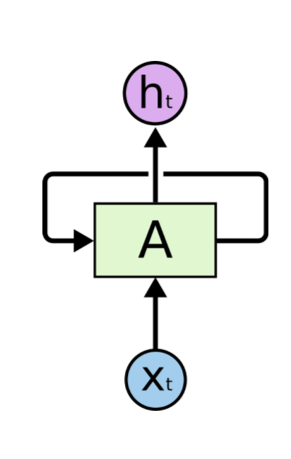
Recurrent Neural Networks (RNN)
Y₀ Y₁ Y₂ Y₃ Y₄ Y_{5 ...} Y_{n}
Output
How can we combine information across a sequence?
Time
X₀ X₁ X₂ X₃ X₄ X_{5 ...} X_{n}
Input
Y₄
RNN
SRN
Y₃
h_{A}
Y₂
h_{A}
Y₁
h_{A}
Y₀
h_{A}
h_{A}
Diagram from Colah's Understanding LSTM Networks http://colah.github.io/posts/2015-08-Understanding-LSTMs/
X₀ X₁ X₂ X₃ X_{4 ...}

Slide 30
Recurrent Neural Networks (RNN)
Y₀ Y₁ Y₂ Y₃ Y₄ Y_{5 ...} Y_{n}
Output
How can we combine information across a sequence?
Idea Repeat the same sub-network at each position and combine information across the sequence by feeding pos_{n} to pos_{n+1}
Simple Recurrent Network (SRN) fully connected hidden layer connecting one position to the next.
Problem Network depth Sequence Length Long sequences construct deep networks More training time Vanishing gradients
Time
X₀ X₁ X₂ X₃ X₄ X_{5 ...} X_{n}
Input
Y₄
RNN
SRN
Y₃
h_{A}
Y₂
h_{A}
Y₁
h_{A}
Y₀
h_{A}
h_{A}
Diagram from Colah's Understanding LSTM Networks http://colah.github.io/posts/2015-08-Understanding-LSTMs/
X₀ X₁ X₂ X₃ X_{4 ...}

Slide 31
Backpropagation
Important for really understanding RNNs

Slide 32

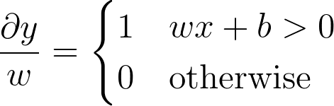
Optimizing model parameters
How do we fit model parameters to our data?
Target Output
Actual Output
Current Input Act. Func.
Desired Input Act. Func.
o
i
Notes:
y = \mathrm{ReLU} (w x + b)

Slide 33
Optimizing model parameters
How do we fit model parameters to our data?
Idea minimize the difference between current and desired model output. Analytical solutions are not available for most models.
Gradient methods can be flexibly and automatically applied to models built from differential functions Mechanics Calculate the rate the output changes for each model parameter. Take a step in the direction toward the desired output. Step size controlled by hyperparameter η
Target Output
Actual Output
Current Input Act. Func.
Desired Input Act. Func.
o
i
Notes:
y = \mathrm{ReLU} (w x + b)

Slide 34
Optimizing with multiple layers
Output layer
What about models with multiple layers?
Target Output
Actual Output
o
Current Input Act. Func.
h
Desired Input Act. Func.
Hidden layer
i
Target Output?
Actual Output
Current Input Act. Func.

Slide 35
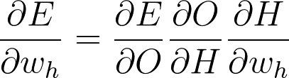
Optimizing with multiple layers
Output layer
What about models with multiple layers?
Idea Recursively push error signal back to earlier layers. Chain Rule allows us to calculate hidden layer error signals based on local activations combined with the error signal at the next network layer.
Mathematically works to arbitrary network depth. Functionally error signals get weaker as more layers are added, known at the vanishing gradient problem.
Target Output
Actual Output
o
Current Input Act. Func.
h
Desired Input Act. Func.
Hidden layer
i
Target Output?
Actual Output
Current Input Act. Func.

Slide 36
Vanishing Gradient
What happens as the network gets deeper?
o
h_{n}
h_{n-1}
h₀

Slide 37
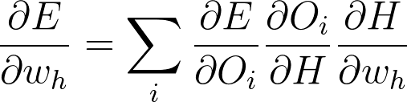
Vanishing Gradient
What happens as the network gets deeper?
Chain Rule for Multiple Outputs sums error across all downstream units in the next layer.
Averaging Errors works okay for 1 or 2 hidden layers.
Signal washes out as the network gets deeper. Notable solution add direct linear connections from earlier layers to subsequent layers.
o
h_{n}
h_{n-1}
h₀

Slide 38
Recurrent Neural Networks
Back to....

Slide 39
Problems with SRNs
Observation vanishing gradient problem is amplified by passing full hidden state to itself at each time step.
Error Signal Averaging over full dimension of the hidden layer at each step.
What if hidden units could hold onto their own activation memory until they are needed?
h_{A,t=n}
h_{A,t=n-1}
h_{A,t=0}

Slide 40
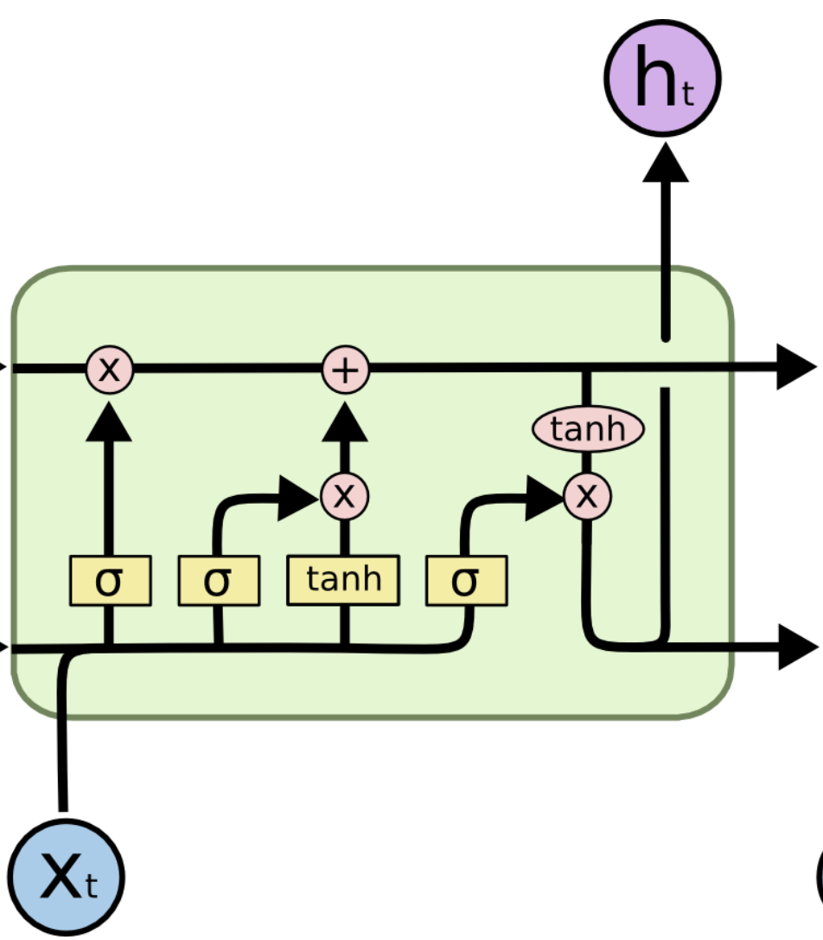
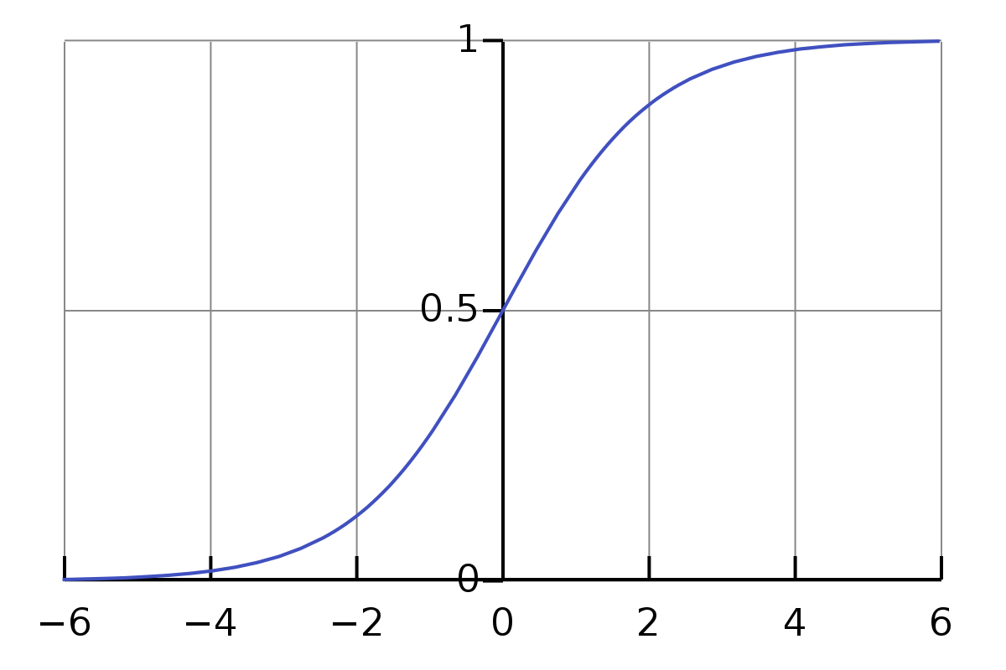

Long Short-Term Memory (LSTM)
What if hidden units could hold onto their own activation memory until they are needed?
Idea replace hidden units with memory cells designed to remember information until its needed. Self connection holds activation from one time step to the next. Input gate selects when to update. Output gate selects when to expose contents. Forget gate selects when to forget info. that is no longer useful. Sigmoid Based Gating
Design Features
Forget G.
Remember G.
Input
Output G.
Diagram from Colah's Understanding LSTM Networks http://colah.github.io/posts/2015-08-Understanding-LSTMs/
σ gating is differentiable! Trainable using gradient methods
Notes:
x_{\mathrm{gated}} = \sigma(x, h_{t-1})\, x

Slide 41
LSTM Tasks
What tasks are a good fit for LSTMs?
Forget G.
Input G.
Input
Output G.
Diagram from Colah's Understanding LSTM Networks http://colah.github.io/posts/2015-08-Understanding-LSTMs/
Notes:
x_{\mathrm{gated}} = \sigma(x, h_{t-1})\, x

Slide 42
LSTM Tasks
What tasks are a good fit for LSTMs?
Sequence Labeling
Part-of-speech tagging (POS), word sense disambiguation (WSD), syntactic chunking, named entity recognition (NER), Information Extraction (IE), Event Detection. Sequence Transduction
Chatbots (Vinyals and Le 2015), Response Suggestion (Kannan et al., 2016) Machine Translation (Wu et al., 2016), Abstractive Summarization (Chopra et al., 2016), Text Simplification (Wang et al., 2016)
Forget G.
Input G.
Input
Output G.
Diagram from Colah's Understanding LSTM Networks http://colah.github.io/posts/2015-08-Understanding-LSTMs/
Notes:
x_{\mathrm{gated}} = \sigma(x, h_{t-1})\, x

Slide 43
Problems with LSTMs
Are LSTMs the solution to all language problems?
Forget G.
Input G.
Input
Output G.
Diagram from Colah's Understanding LSTM Networks http://colah.github.io/posts/2015-08-Understanding-LSTMs/
Notes:
x_{\mathrm{gated}} = \sigma(x, h_{t-1})\, x

Slide 44
Problems with LSTMs
Are LSTMs the solution to all language problems?
Vanishing gradients are still a problem as sources of gradient noise still present at each time step. Forgetful by the end of the sequence the LSTM may have forgotten the beginning. Emphasis on local context easier to learn and use information over short distances rather than wider context. Design limits GPU acceleration due to sequential dependencies.
Partial solutions Skip connections, bi-LSTM, attention, use alternative network (CNNs, Transformer)
Forget G.
Input G.
Input
Output G.
Diagram from Colah's Understanding LSTM Networks http://colah.github.io/posts/2015-08-Understanding-LSTMs/
Notes:
x_{\mathrm{gated}} = \sigma(x, h_{t-1})\, x

Slide 45

LSTM References
ftp://ftp.idsia.ch/pub/juergen/lstm.pdf
http://colah.github.io/posts/2015-08-Understanding-LSTMs/

Slide 46
End Notes
Agenda
Learning Optimizations
Negative Sampling
Hierarchical Softmax
Processing Sequences
Window Models
Recurrent Neural Network (RNN)
Backpropagation
Long Short-Term Memory (LSTM)
Reminders
Project Proposal: October 14
200-300 words
At least four references
Details in Guidelines

Slide 47
End.

Slide 48
Appendix

Slide 49
Softmax

Slide 50
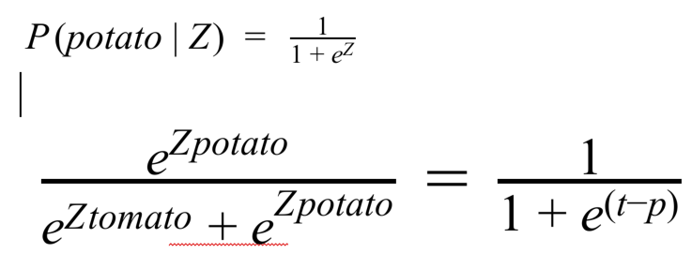
Softmax vs Sigmoid

Slide 51
Hierarchical Softmax
Naturally normalized
What happens during training?
What about scoring?
When does it really not help very much?

Slide 52
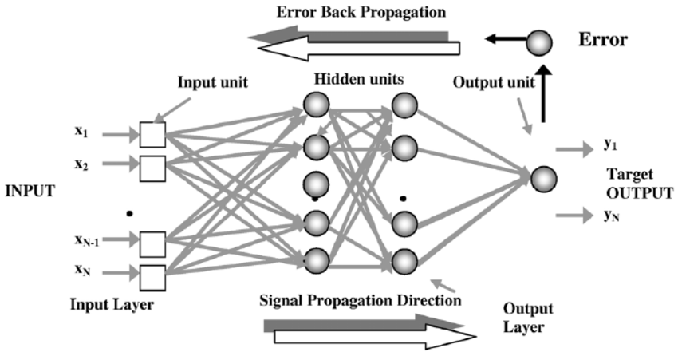
Training: Backpropagation
Gradient descent + Chain rule = Backpropagation
L = CE(y, y_true)
y = σ(a)
a = Wx + b
Parameter update? SGD:
W → W - ɑ·(dL / dW)
(dL / dW)_{ij} = (dL / dW_{ij})
= (dL / dy)(dy / da)(da / dW_{ij})

Slide 53
Reminder: Fully Connected (A1) Neural Networks
Sigmoid Or Softmax
Affine
Nonlinearity
Affine
Affine
z = Wx + b
Nonlinearity
Affine
x₁ x₂

Slide 54
Neural Networks on Text
“Neural Probabilistic Language Model” (NPLM)
Generic architecture: “window model”
Used for tagging and entity recognition
Softmax Output
Concatenated Embeddings
E
E
E
Context Word (L)
Center Word
Context Word (R)

Slide 55
A note on embeddings...
Usually presented as a “lookup” in some table, but…
Think of a word as a one-hot vector: X = [0 0 0 … 0 1 0 …. 0 0 0]
0
0
1
0
0
0
0
E =
“the”
W^{T}
X

Slide 56
Apppendix: More Word2Vec

Slide 57
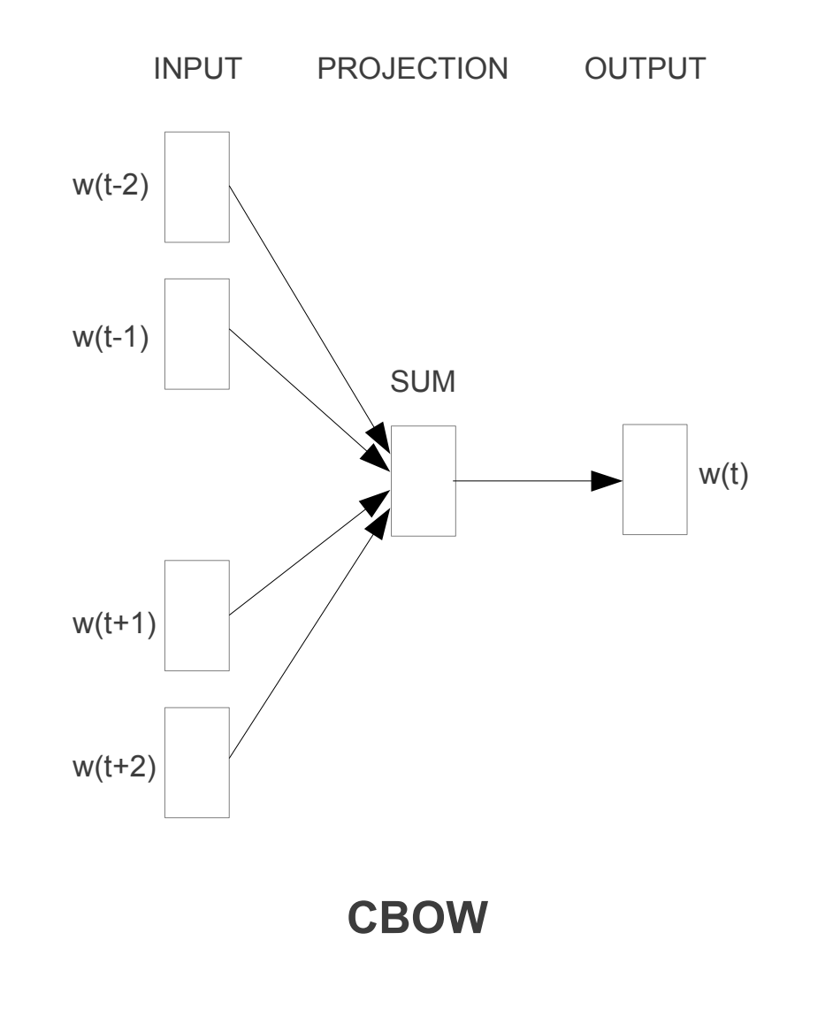
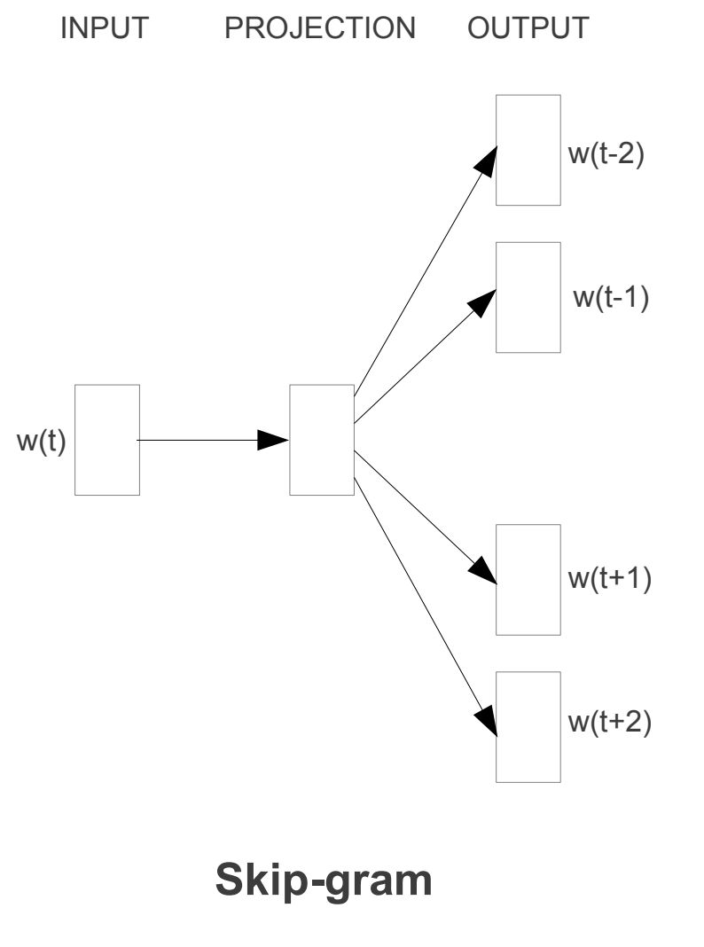
Word2Vec

Slide 58
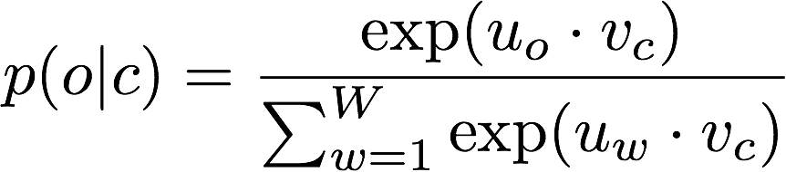
Word2Vec Objective Function
Notes:
Log-likelihood of correct word, aka cross-entropy loss (between predicted distribution and samples from true distribution)

Slide 59
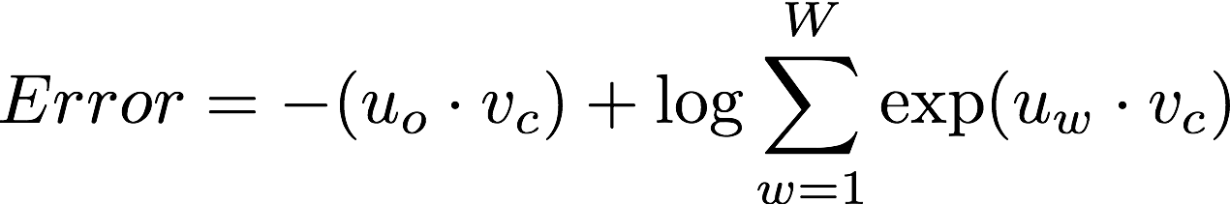
Word2Vec Error
“logsumexp”
Notes:
This is just -log( objective ), so minimizing this is equivalent to maximizing objective (log likelihood)

Slide 60
Word2Vec Error
correct word
incorrect words

Slide 61
Word2Vec Error
Depends on every word in the vocabulary
Slow on large datasets

Slide 62
Apppendix: Other Optimization Techniques

Slide 63
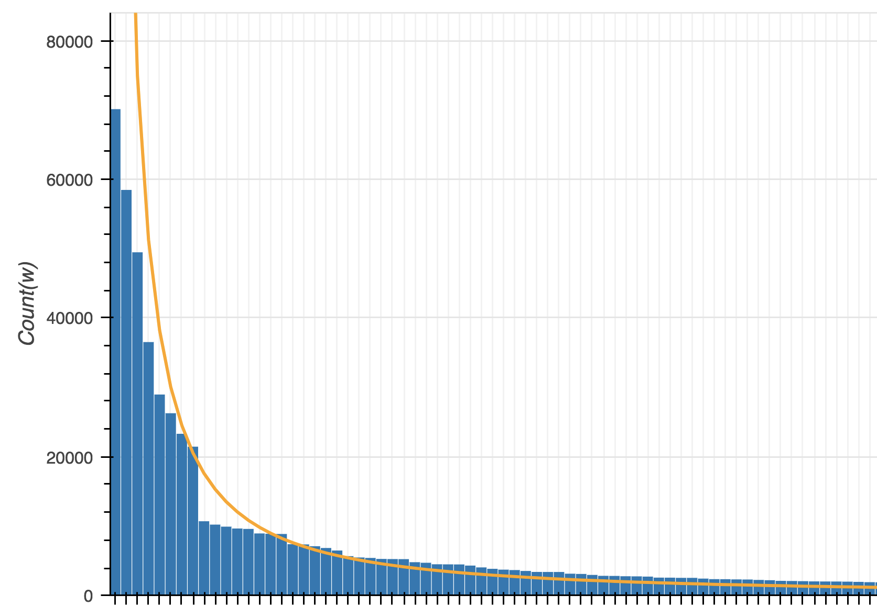
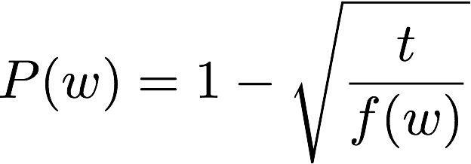
Subsampling
“the”, “in”, “and”, etc. occur many times
Little gain from additional training
Discard frequent words with
and
the
of
to
Notes:
t is some threshold (around 10e-5)
f(w) is the frequency of the word

